Slide 1
Digital Fundamentals
CHAPTER 5 Combinational Logic Analysis

Slide 2
Basic Combinational Logic Circuits

Slide 3
Basic Combinational Logic Circuits
AND-OR Logic
AND-OR-Invert Logic
Exclusive-OR Logic

Slide 4
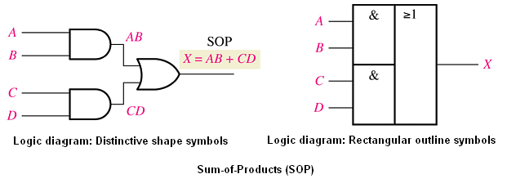
Basic Combinational Logic Circuits
AND-OR Logic

Slide 5
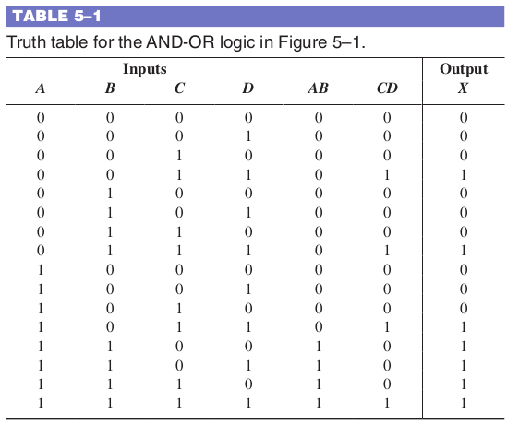
Basic Combinational Logic Circuits
AND-OR Logic

Slide 6
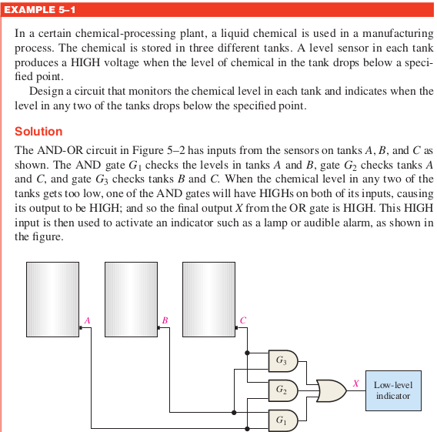
Basic Combinational Logic Circuits
AND-OR Logic

Slide 7
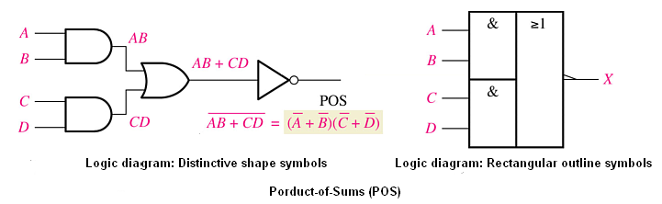
Basic Combinational Logic Circuits
AND-OR Invert Logic
Truth Table
A truth table can be developed from the AND-OR truth table in Table 5–1 by
simply changing all 1s to 0s and all 0s to 1s in the output column.

Slide 8
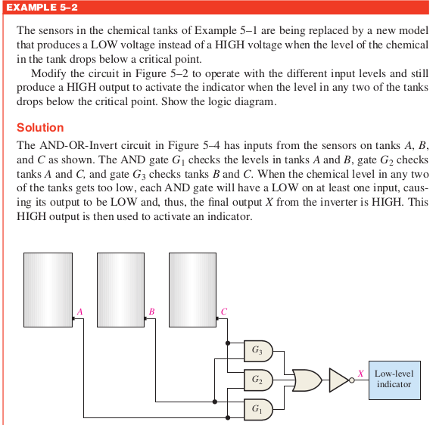
Basic Combinational Logic Circuits
AND-OR Invert
Logic

Slide 9
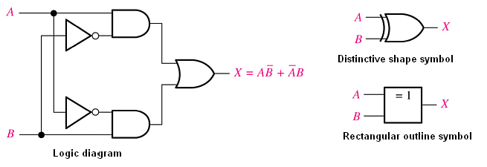
Basic Combinational Logic Circuits
Exclusive-OR Logic
output is HIGH only when the two inputs are at opposite levels
X = A ⊕ B (X is equal to A exclusive-OR B)

Slide 10
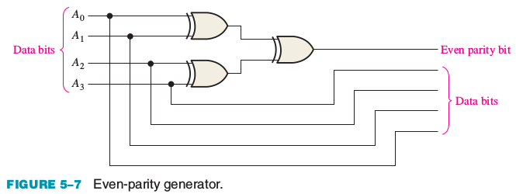
Example 5-3: Basic Combinational Logic Circuits
Use exclusive-OR gates to implement an even-parity code generator for an original
4-bit code.
Solution
Recall from Chapter 2 that a parity bit is added to a binary code in order to provide error detection. For even parity, a parity bit is added to the original code to make the total number of 1s in the code even. The circuit in Figure 5–7 produces a 1 output when there is an odd number of 1s on the inputs in order to make the total number of 1s in the output code even. A 0 output is produced when there is an even number of 1s on the inputs.

Slide 11
Example 5-3: Basic Combinational Logic Circuits
Use exlusive-OR gates to implement an even-parity checker for the 5-bit code generated by the circuit in Example 5–3.
Solution
The circuit in Figure 5–8 produces a 1 output when there is an error in the five-bit code and a 0 when there is no error.

Slide 12
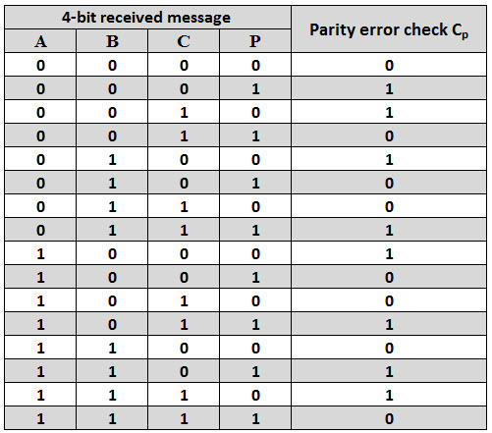
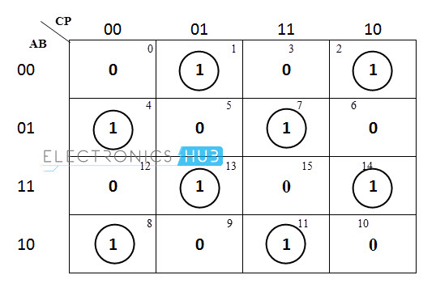
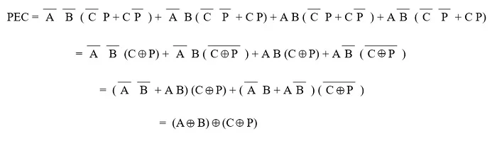
Example 5-3: Basic Combinational Logic Circuits

Slide 13
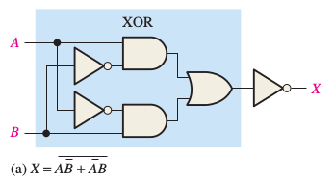
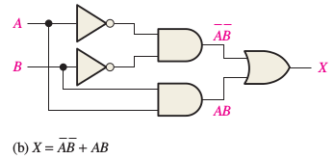
Basic Combinational Logic Circuits
Exclusive-NOR Logic
FIGURE 5–6 Two equivalent ways of implementing the exclusive-NOR.

Slide 14
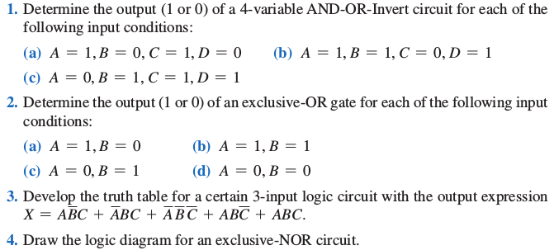
Basic Combinational Logic Circuits
Checkup

Slide 15
5–2 Implementing Combinational Logic
Implement a logic circuit from a Boolean expression
Implement a logic circuit from a truth table
Minimize a logic circuit

Slide 16
Implementing Combinational Logic
From Boolean expression to logic circuit
Given a Boolean expression, create a logic circuit that implements that expression.
From truth table to logic circuit
Given a truth table, create a logic circuit that implements that table.

Slide 17


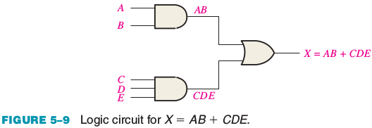
Implementing Combinational Logic
Let’s examine the following Boolean expression:
X = AB + CDE

Slide 18
Implementing Combinational Logic
Another example, let’s implement the following expression:
X = AB(CD + EF)
AND
OR
NOT
The logic gates required to implement X = AB(CD + EF) are as follows:
One inverter to form D
Two 2-input AND gates to form CD and EF
One 2-input OR gate to form CD + EF
One 3-input AND gate to form X

Slide 19
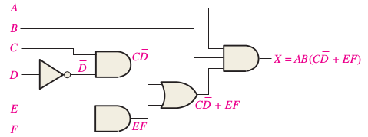
Implementing Combinational Logic
Another example, let’s implement the following expression:
X = AB(CD + EF)
FIGURE 5–10 Logic circuits for X = AB(CD + EF )

Slide 20
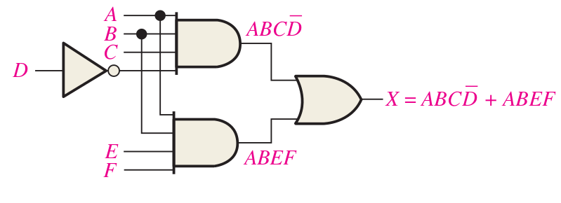
Implementing Combinational Logic
Another example, let’s implement the following expression:
X = AB(CD + EF)
= ABCD + ABEF
FIGURE 5–10 Logic circuits for X = AB(CD + EF ) = ABCD + ABEF.

Slide 21
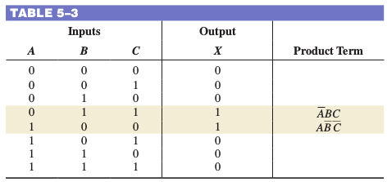
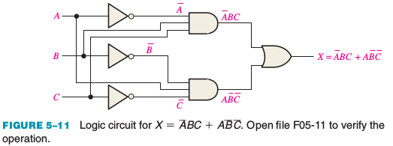
Truth Table: Implementing Combinational Logic
X = ABC + AB C

Slide 22
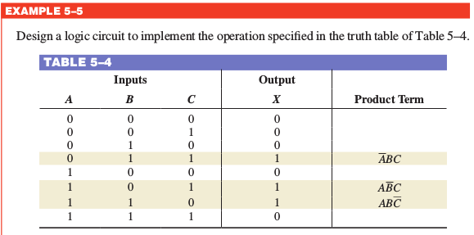
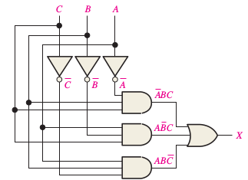
Truth Table: Implementing Combinational Logic
X = ABC + AB C+ABC

Slide 23
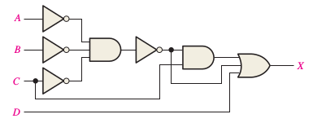
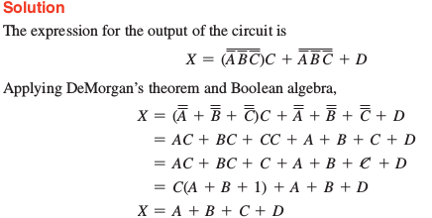
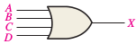
Implementing Combinational Logic
EXAMPLE 5–7
Reduce the combinational logic circuit in Figure 5–14 to a minimum form.
1
A
A B C
A B C
(A B C)C
2
B
4
5
6
3
C
7
(A B C)C+D

Slide 24
5–3 The Universal Property of NAND and NOR Gates
The universality of the NAND gate means that it can be used as an inverter and that combinations of NAND gates can be used to implement the AND, OR, and NOR operations. Similarly, the NOR gate can be used to implement the inverter (NOT), AND, OR, and NAND operations.

Slide 25
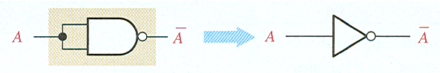
The Universal Property of NAND Gates
NAND Gate as an Inverter
An inverter can be made from a NAND gate by connecting
all of the inputs together and creating, in effect, a single input

Slide 26
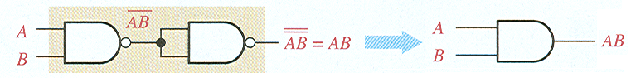
The Universal Property of NAND Gates
Two NAND Gates as an AND Gate

Slide 27
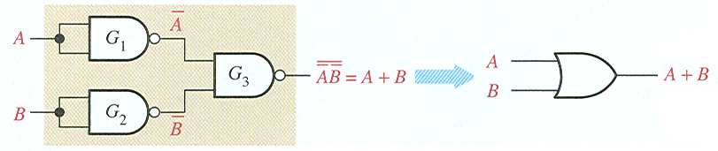
The Universal Property of NAND Gates
Three NAND Gates as an OR Gate

Slide 28
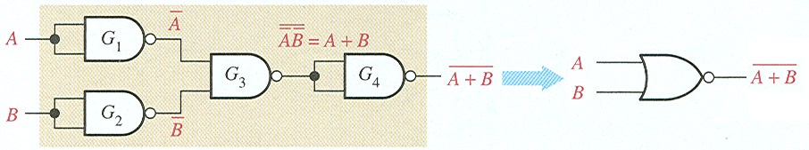
The Universal Property of NAND Gates
Four NAND Gates as NOR Gate

Slide 29
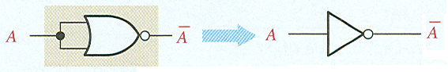
The Universal Property of NOR Gates
NOR Gate as an Inverter

Slide 30
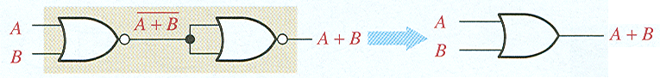
The Universal Property of NOR Gates
Two NOR Gates as an OR Gate

Slide 31
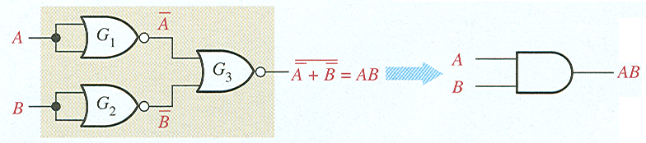
The Universal Property of NOR Gates
Three NOR Gates as an AND Gate

Slide 32
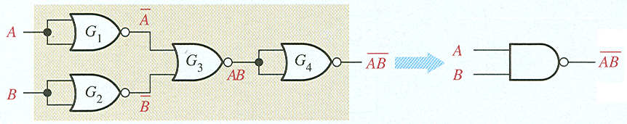
The Universal Property of NOR Gates
Four NOR Gates as an NAND Gate

Slide 33
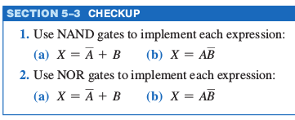

Slide 34
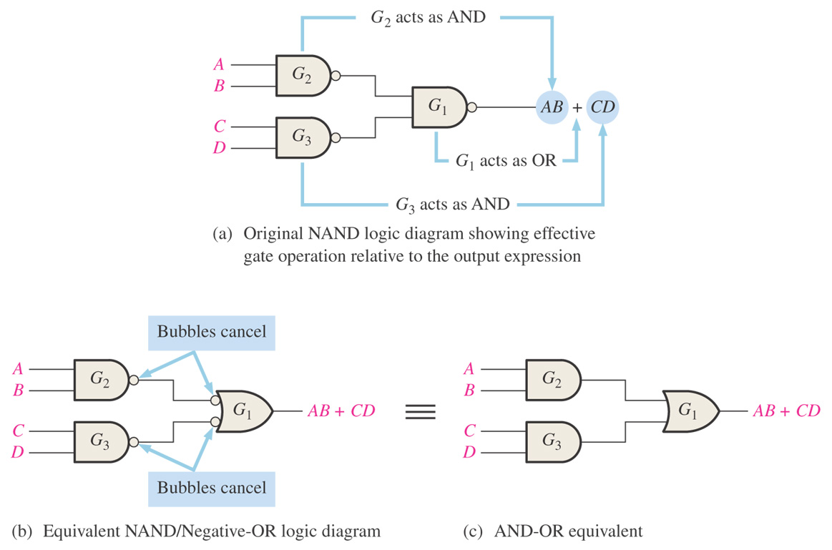
Figure 5–19 Development of the AND-OR equivalent of the circuit in Figure 5–18.
Thomas L. Floyd Digital Fundamentals, 9e
Copyright ©2006 by Pearson Education, Inc. Upper Saddle River, New Jersey 07458 All rights reserved.

Slide 35
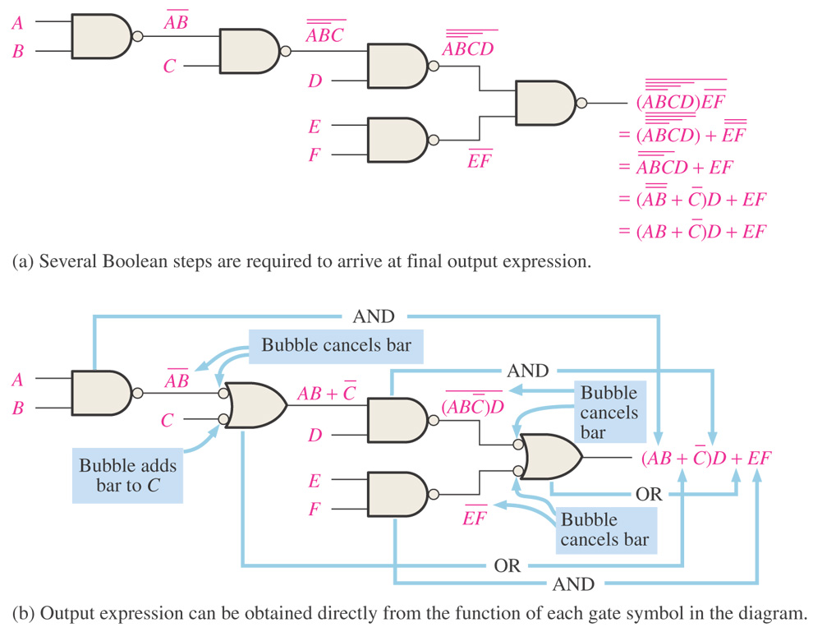
Figure 5–20 Illustration of the use of the appropriate dual symbols in a NAND logic diagram.
Thomas L. Floyd Digital Fundamentals, 9e
Copyright ©2006 by Pearson Education, Inc. Upper Saddle River, New Jersey 07458 All rights reserved.

Slide 36
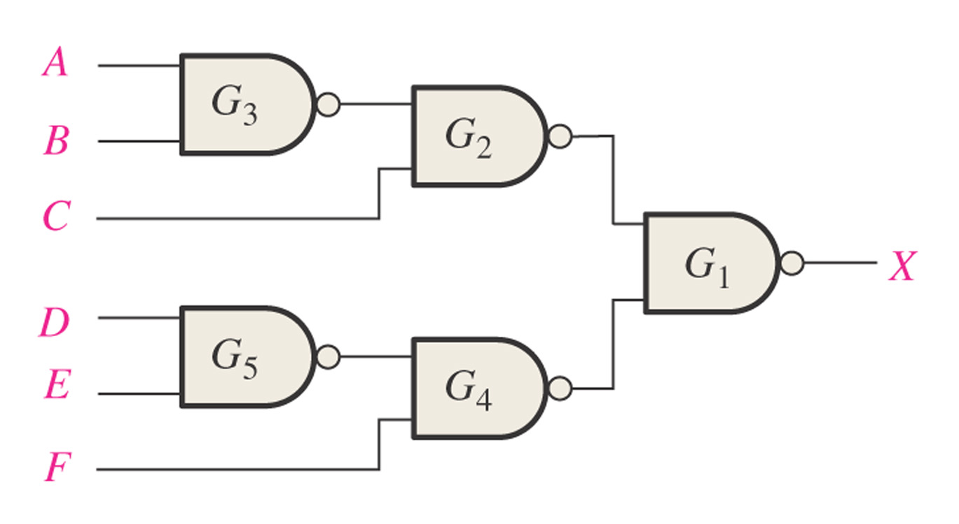
Figure 5–21
Example 5-9. Redraw using appropriate dual symbols.
Thomas L. Floyd Digital Fundamentals, 9e
Copyright ©2006 by Pearson Education, Inc. Upper Saddle River, New Jersey 07458 All rights reserved.

Slide 37
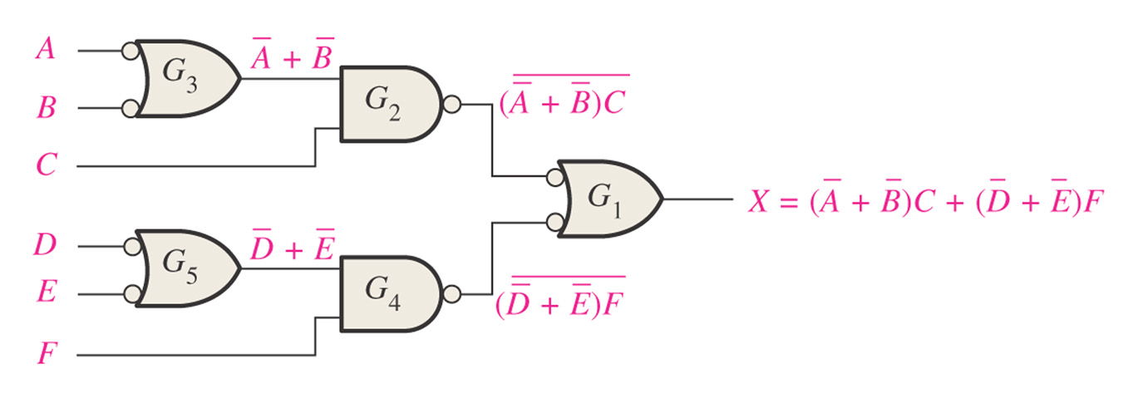
Figure 5–22
Thomas L. Floyd Digital Fundamentals, 9e
Copyright ©2006 by Pearson Education, Inc. Upper Saddle River, New Jersey 07458 All rights reserved.

Slide 38
NOR Logic – Negative AND
A + B = A B
NOR negative AND

Slide 39
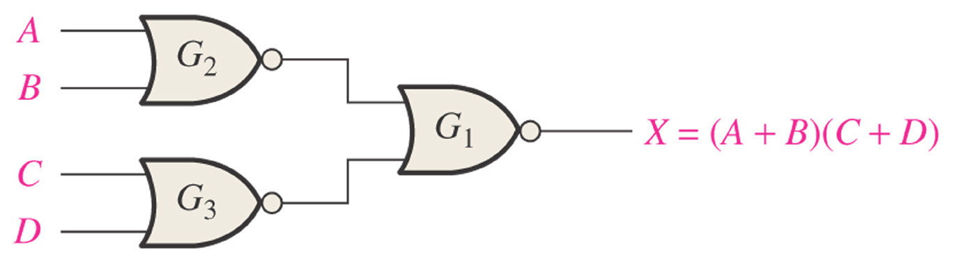
Figure 5–24 NOR logic for X = (A + B)(C + D).
NOR Logic – Negative AND
Thomas L. Floyd Digital Fundamentals, 9e
Copyright ©2006 by Pearson Education, Inc. Upper Saddle River, New Jersey 07458 All rights reserved.

Slide 40
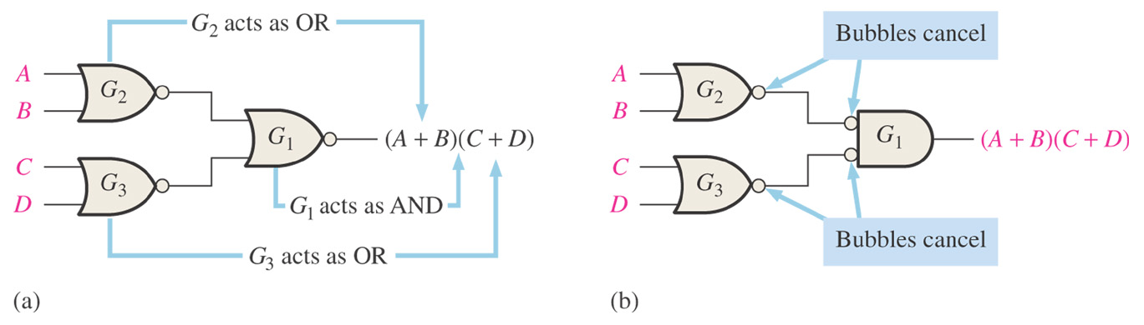
Figure 5–25
Thomas L. Floyd Digital Fundamentals, 9e
Copyright ©2006 by Pearson Education, Inc. Upper Saddle River, New Jersey 07458 All rights reserved.

Slide 41
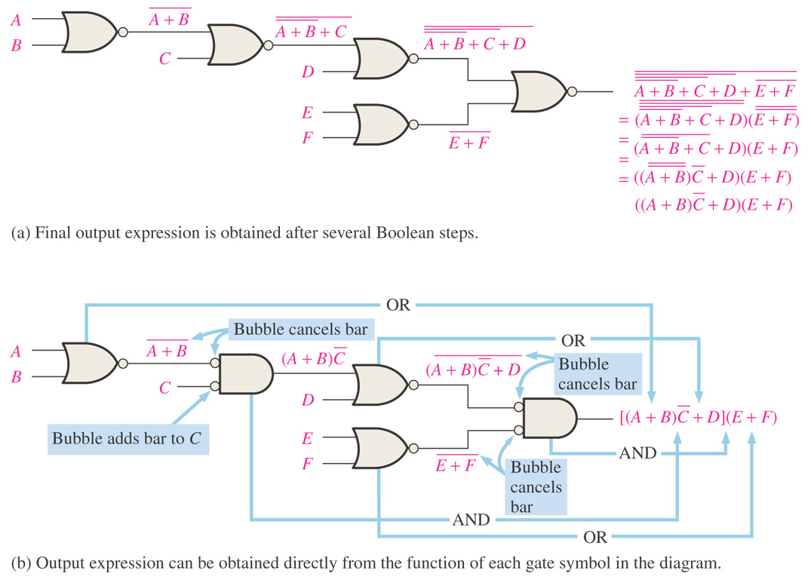
Figure 5–26 Illustration of the use of the appropriate dual symbols in a NOR logic diagram.
Thomas L. Floyd Digital Fundamentals, 9e
Copyright ©2006 by Pearson Education, Inc. Upper Saddle River, New Jersey 07458 All rights reserved.

Slide 42
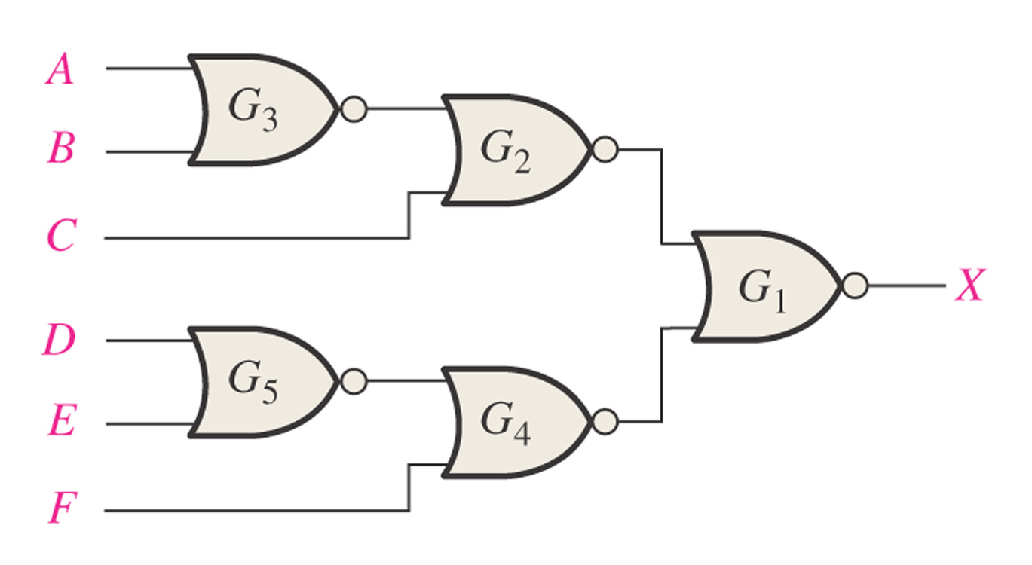
Figure 5–27
Redraw using appropriate Dual symbols.
Thomas L. Floyd Digital Fundamentals, 9e
Copyright ©2006 by Pearson Education, Inc. Upper Saddle River, New Jersey 07458 All rights reserved.

Slide 43
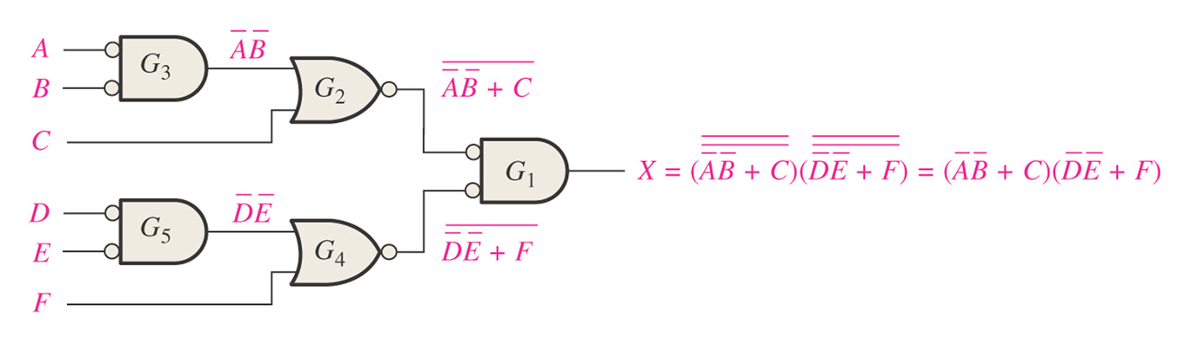
Figure 5–28
Thomas L. Floyd Digital Fundamentals, 9e
Copyright ©2006 by Pearson Education, Inc. Upper Saddle River, New Jersey 07458 All rights reserved.

Slide 44
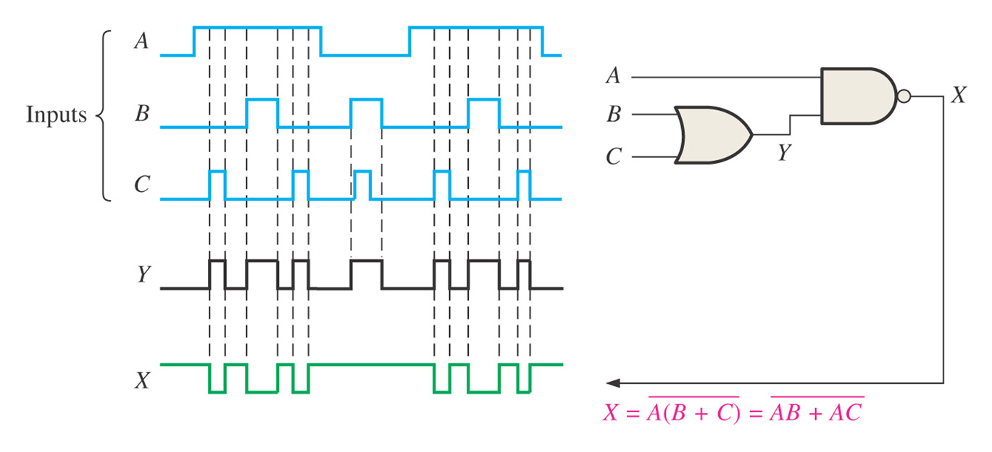
Figure 5–29
Thomas L. Floyd Digital Fundamentals, 9e
Copyright ©2006 by Pearson Education, Inc. Upper Saddle River, New Jersey 07458 All rights reserved.

Slide 45
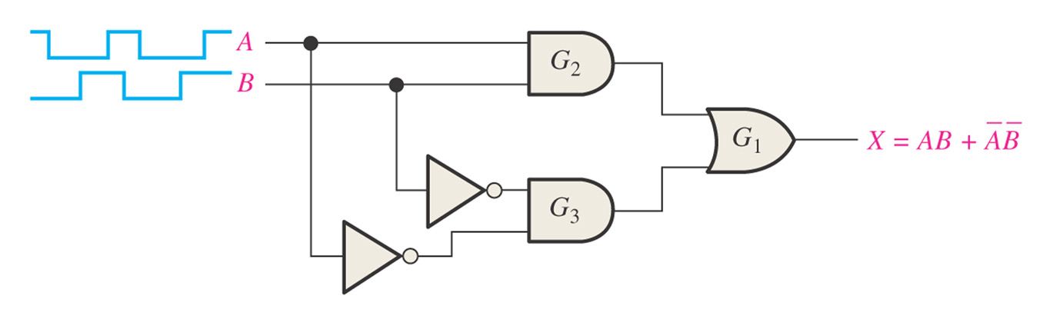
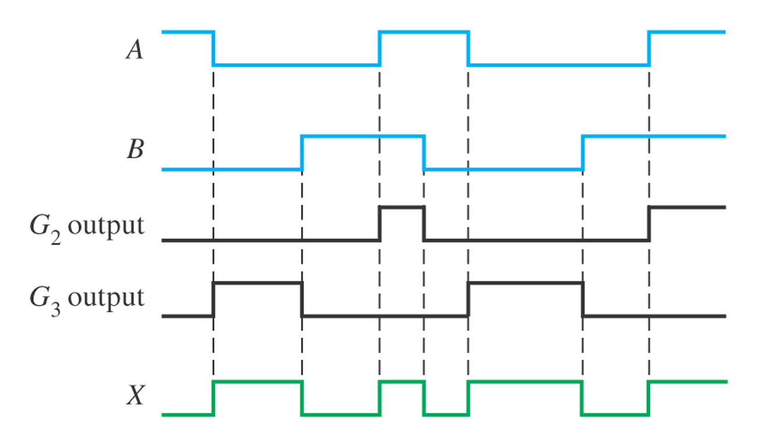
Figure 5–30
Draw the timing diagram with the given inputs
Thomas L. Floyd Digital Fundamentals, 9e
Copyright ©2006 by Pearson Education, Inc. Upper Saddle River, New Jersey 07458 All rights reserved.

Slide 46
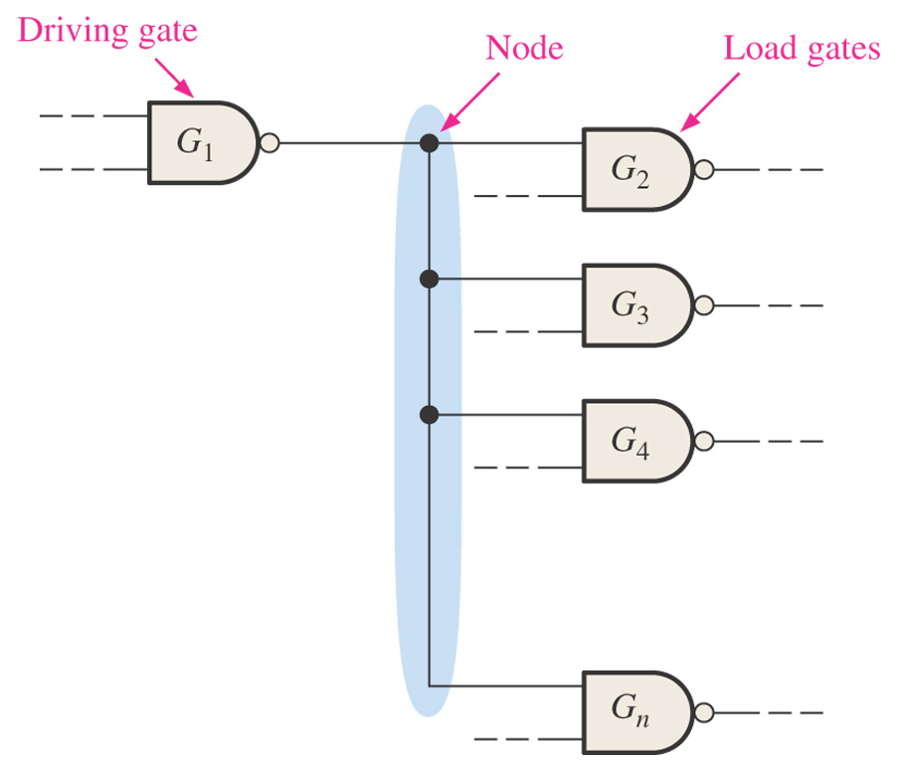
Figure 5–42 Illustration of a node in a logic circuit.
Troubleshooting
Thomas L. Floyd Digital Fundamentals, 9e
Copyright ©2006 by Pearson Education, Inc. Upper Saddle River, New Jersey 07458 All rights reserved.

Slide 47
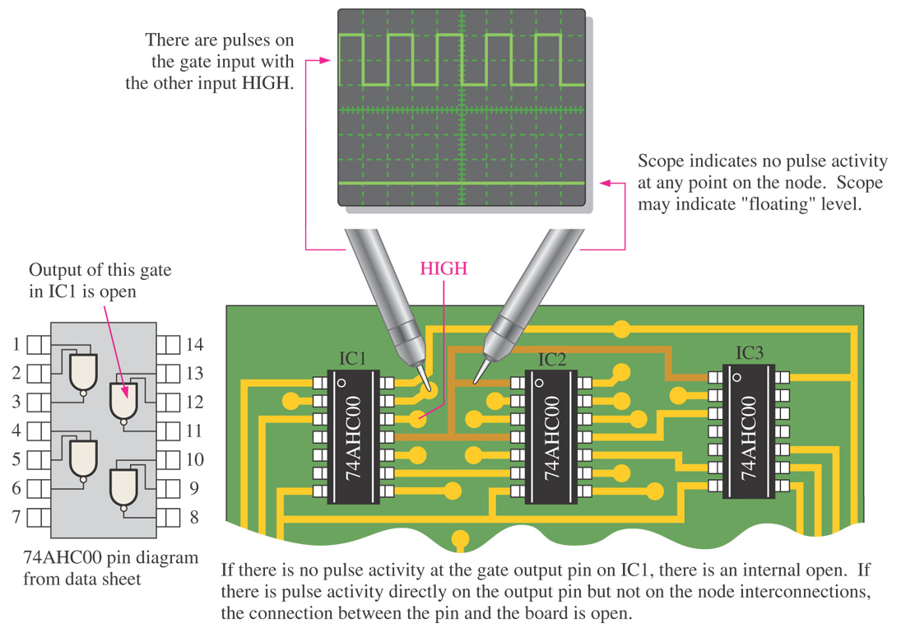
Figure 5–43 Open output in driving gate. For simplicity, assume a HIGH is on one gate input.
Thomas L. Floyd Digital Fundamentals, 9e
Copyright ©2006 by Pearson Education, Inc. Upper Saddle River, New Jersey 07458 All rights reserved.

Slide 48
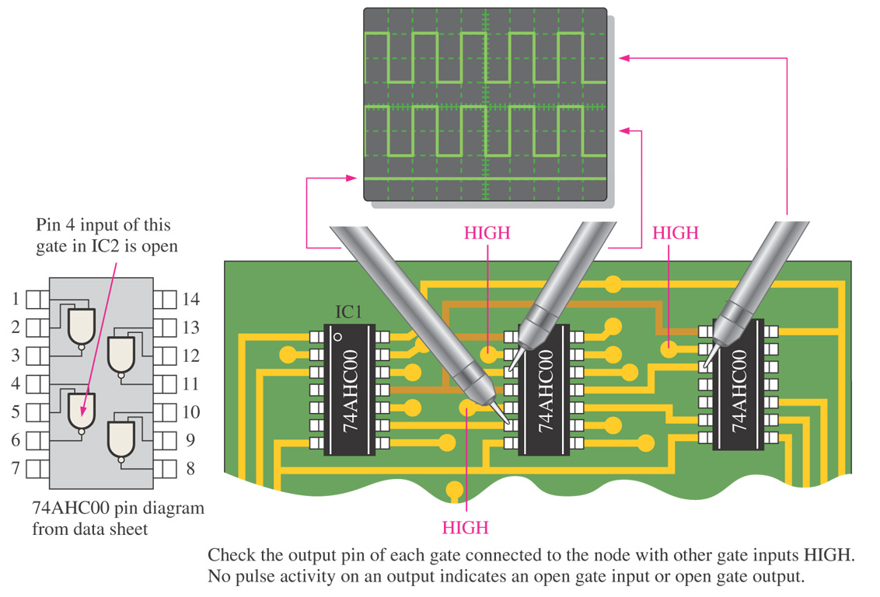
Figure 5–44 Open input in a load gate.
Thomas L. Floyd Digital Fundamentals, 9e
Copyright ©2006 by Pearson Education, Inc. Upper Saddle River, New Jersey 07458 All rights reserved.

Slide 49
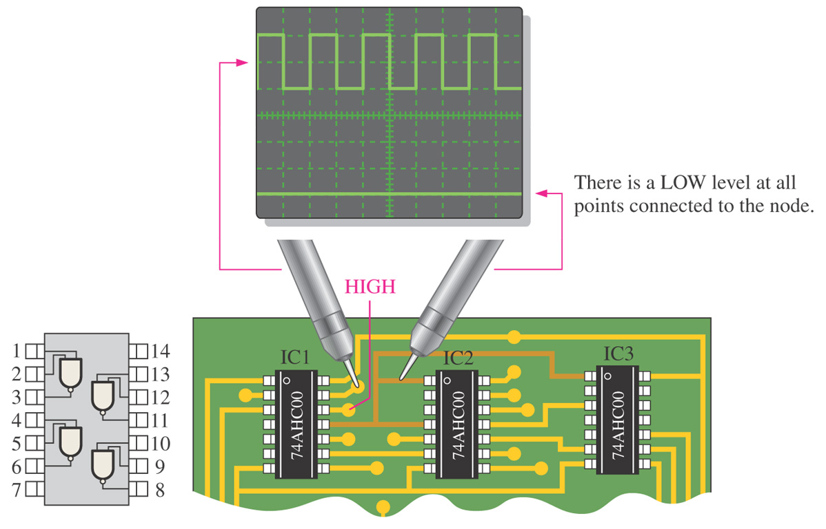
Figure 5–45 Shorted output in the driving gate or shorted input in a load gate.
Thomas L. Floyd Digital Fundamentals, 9e
Copyright ©2006 by Pearson Education, Inc. Upper Saddle River, New Jersey 07458 All rights reserved.

Slide 50
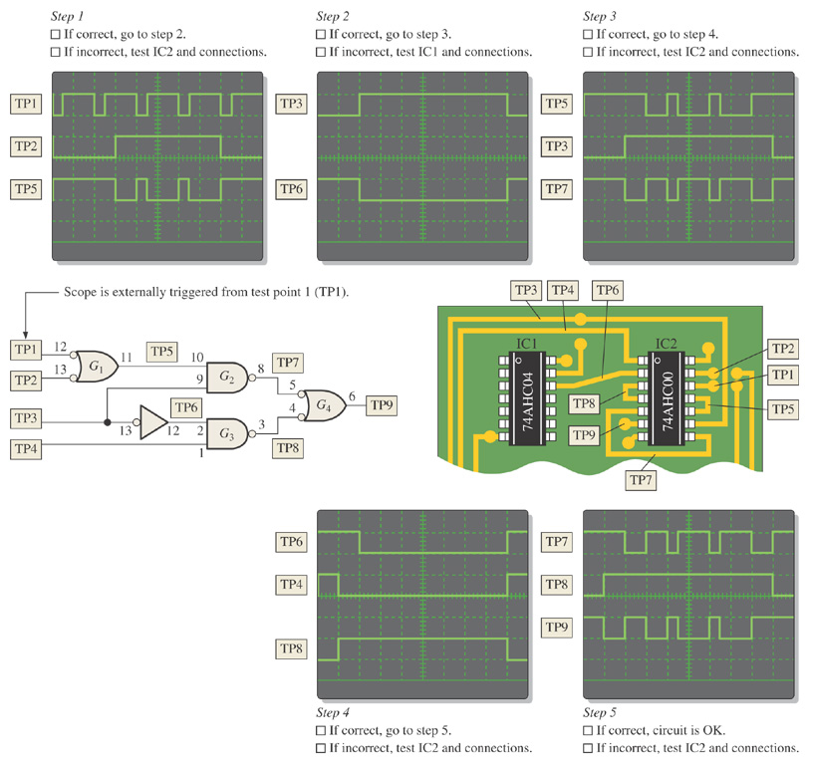
Figure 5–46 Example of signal tracing and waveform analysis in a portion of a printed circuit board. TP indicates test point.
Thomas L. Floyd Digital Fundamentals, 9e
Copyright ©2006 by Pearson Education, Inc. Upper Saddle River, New Jersey 07458 All rights reserved.

Slide 51
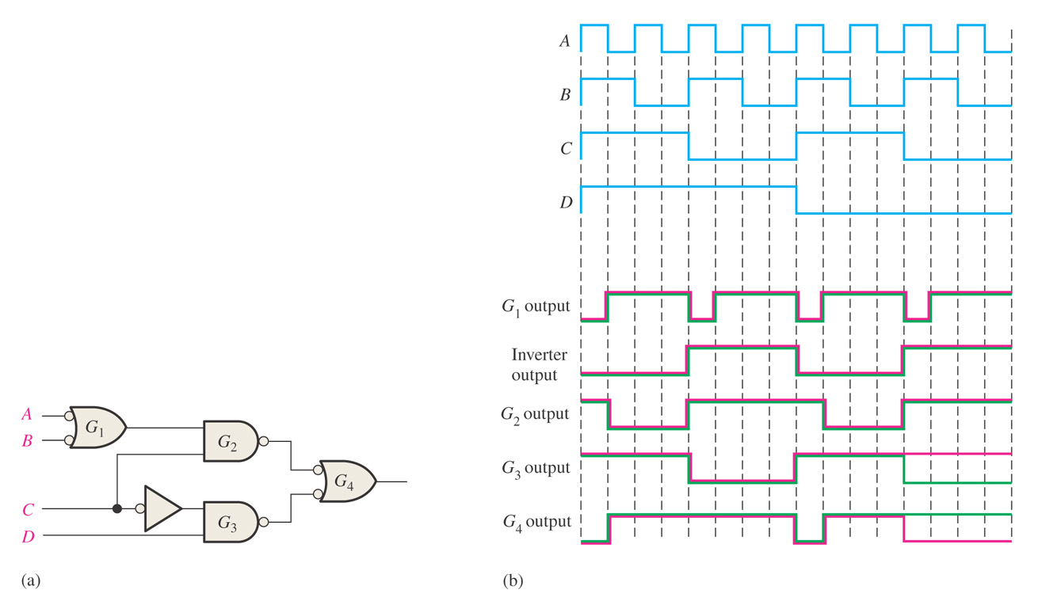
Figure 5–47
Determine the fault in the circuit. Red line shows correct waveform. Green line is incorrect waveform.
Thomas L. Floyd Digital Fundamentals, 9e
Copyright ©2006 by Pearson Education, Inc. Upper Saddle River, New Jersey 07458 All rights reserved.

Slide 52
VHDL
V – VHSIC – Very High Speed Integrated Circuit
HDL – Hardware Description Language
Component name_of_component is
port (port definitions);
End component name_of_component

Slide 53

Figure 5–36 Predefined programs for a 2-input AND gate and a 2-input OR gate to be used as components in the data flow approach.
Thomas L. Floyd Digital Fundamentals, 9e
Copyright ©2006 by Pearson Education, Inc. Upper Saddle River, New Jersey 07458 All rights reserved.

Slide 54

Figure 5–40 A VHDL program for a combinational logic circuit after entry on a generic text editor screen that is part of a software development tool.
Thomas L. Floyd Digital Fundamentals, 9e
Copyright ©2006 by Pearson Education, Inc. Upper Saddle River, New Jersey 07458 All rights reserved.

Slide 55

Figure 5–41 A typical waveform editor tool showing the simulated waveforms for the logic circuit described by the VHDL code in Figure 5–40.
Thomas L. Floyd Digital Fundamentals, 9e
Copyright ©2006 by Pearson Education, Inc. Upper Saddle River, New Jersey 07458 All rights reserved.

